Slide 1
LINQ Language Integrated Query Chapter 17 LINQ to SQL
Book: ADO.NET 4 C#
© 2011, Mike Murach & Associates, Inc.

Slide 2
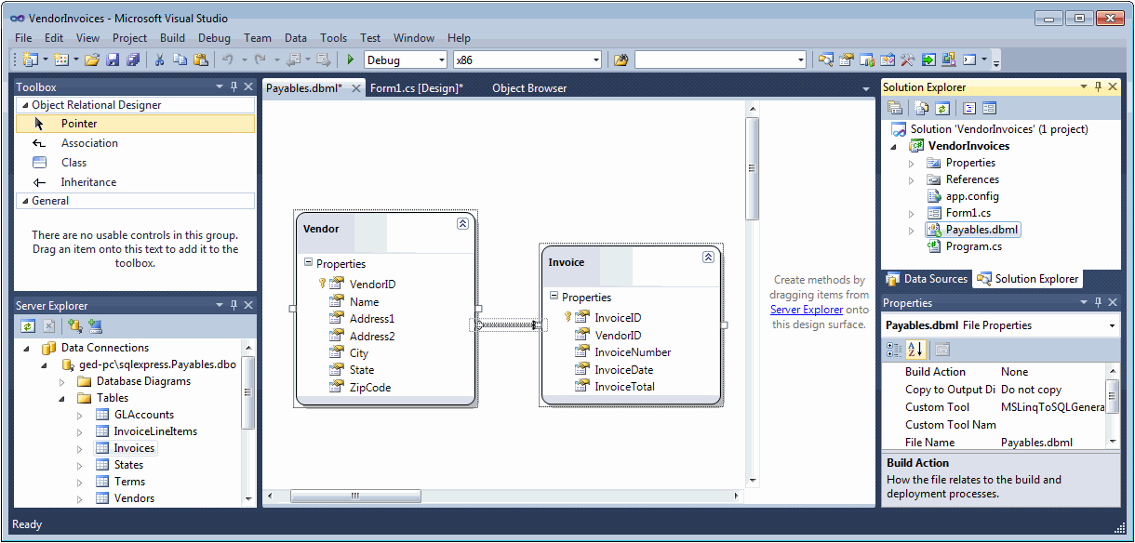
Arrow shows the PK-FK relationship which is a 1 to many
Invoice class will have a property named Vendor that you can use to get that information back that was in the Vendors table (e.g. Vendor.City)
Likewise, the Vendor class will have a property named Invoices that you can refer to the collection of invoices from that vendor
Notes:
2

Slide 3
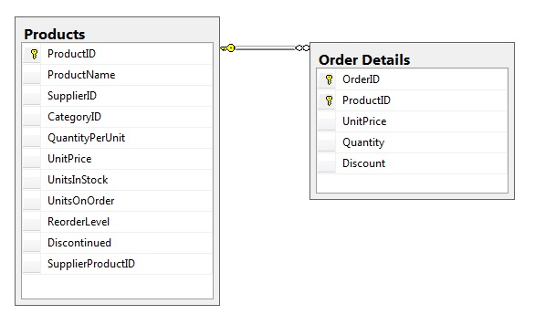

Slide 5
// Q2 step, define the query expression, this time with a join, so we can get the product name
string orderDisplay = "Quantity\t\tProduct\n"; // flipped the order, just cause tabs work better
var orders = from myOrders in myOrderDetail.Order_Details // made up name myOrders
// now add the join
// first, add the 2nd table to the query
join myProducts in myOrderDetail.Products // myProducts is another made up range variable name
on myOrders.ProductID // declare which columns should match in the 2 tables
equals myProducts.ProductID //use of made-up range variable as token for objects in returned list
where myOrders.Quantity > 79 //myOrders object has the same properties as the table column names
orderby myOrders.Quantity ascending
// choosing a new column ( ProductName) from the joined table, Products
select new { myProducts.ProductName, myOrders.Quantity };
// that all sets up a differed query, which we will use next
// Q3 - Execute the query to return the results
foreach (var orderItem in orders) // orderItem is just a made up name, orders is our query expression
{
orderDisplay += orderItem.Quantity.ToString() + "\t\t" + // first col
orderItem.ProductName + "\n"; // second column appended to the string
}
MessageBox.Show(orderDisplay, "> 79 orders Product");

Slide 6
Instead of an overt Join, use the built in Association capability of LINQ
Make a copy of the 2nd program, and change this code:
var orders = from myOrders in myOrderDetail.Order_Details
// no need to do a join, the Association is provided by LINQ-to-SQL based of the PK-FK relationship from the DB
// same code as last 2 versions
where myOrders.Quantity > 79
orderby myOrders.Quantity ascending
// V2 code relying on overt join
select new { myVendors.ProductName, myOrders.Quantity };
// choosing a new column from the joined table, Products
// new code
select new { myOrders.Product.ProductName, myOrders.Quantity };
//can instead just reference it through the Product.ProductName which is
//in myOrders because LINQ pulls in all those fields linked by the PK-FK
2-3-Query-C-Assoc

Slide 7
DataContext class
myOrders.Product.ProductName,
Database Connection information and capability
Products Entity Class (with members that map to fields)
And an Order Details Entity Class (with members that map to fields)
And an Association attribute Product

